Slide 1



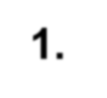
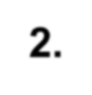

Entrepreneurship and
Small Business Management
Becoming an Entrepreneur
Small Business Basics
Starting a Small Business
1.
SLIDE 1

Slide 2
Becoming an Entrepreneur
Goal 1
Goal 2
Goal 3
Identify characteristics of successful entrepreneurs.
Recognize the importance of entrepreneurship in the economy. Describe opportunities and risks of entrepreneurship.
SLIDE 2

Slide 3
Entrepreneurship and Entrepreneurs
Entrepreneurship – • Accepting the risk of starting and running a
business.
Entrepreneur:
Person conducting own business (Webster)
Organizer of an economic venture, one who owns, organizes, manages, and assumes the risks of the business (Chandrashekhar

Slide 4
Role of the Entrepreneur
An innovator
Risk taker
Driver
Organizer
Starter
Accountable & responsible

Slide 5

NOTABLE ENTREPRENEURS

Slide 6
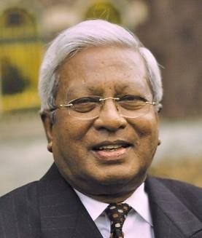
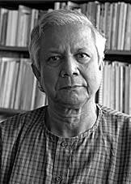
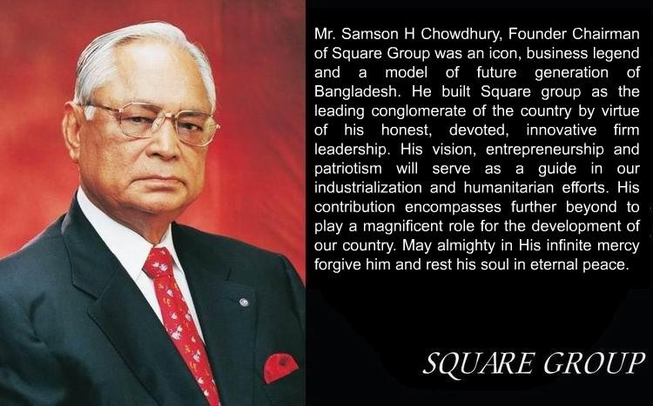
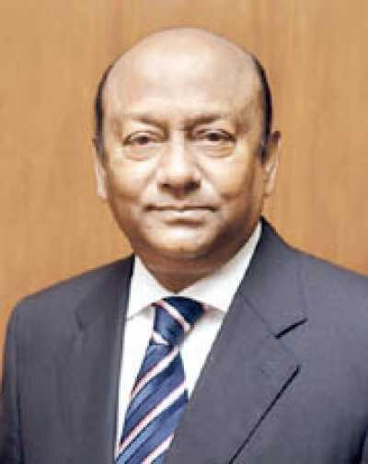
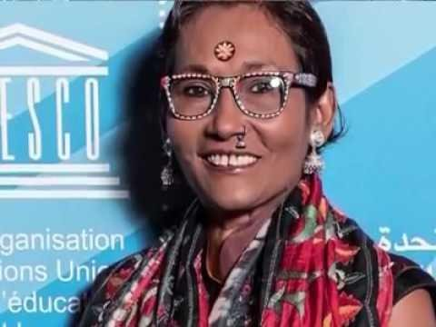
Famous Entrepreneurs – Bangladesh
Muhammad Yunus
Fazle Hasan Abed
Latifur Rahman
Bibi Russel

Slide 7
YOU’RE NEVER TOO YOUNG to be an
ENTREPRENEUR (Spotlight on Small Business)
Leanna Archer – At 12 years old, she has her own hair care line.
Alexis Holmes – Started baking for a fundraiser, now the 16-year-old owns her own bakery.
Jack Short & Daniel Lyons – The two medical students started Factory Green, a carbon neutral apparel company, as undergrads.
Mark Zuckerberg – Launched Facebook as a Harvard freshman.

Slide 8
KEY TERMS
Entrepreneur- the individual that is a risk taker and innovator.
Entrepreneurship- the business that is creative and risky.
Characteristics of an entrepreneur: Creative, confident, goal-oriented, motivated, hard-working
Risks of an entrepreneur: : Unproven idea, little management experience, long-hours with no guarantee of a profit

Slide 9
KEY TERMS
Venture Capital- Money provided by large investors to finance new products and new businesses that have a good chance to be very profitable
*Innovation- a brand new creation or invention
*Improvements- a significant design change or addition on an existing product

Slide 10
Entrepreneurship VS Working for others
Entrepreneurship
Own the business
Freedom to succeed as well as freedom to fail
Do not receive any benefits such as paid vacation time, day care, a company car or health insurance.
Working for others
Somebody else assumes entrepreneurial risk
Provides with benefits such as paid vacation and health insurance.

Slide 11
3 Reasons most small businesses fail
Lack of money
Lack of management experience
Not keeping adequate records

Slide 12

Checkpoint ✔
What are the sources of financing that entrepreneurs use for their new businesses?
Personal savings
Friends and family
Venture capital
Bank loans

Slide 13
BUSINESS PLAN
Business Plan- a written description of the business idea and how it will be carried out.
5 ELEMENTS
Description of the business & goals
Customer Analysis- knowing your customer
Operations Plan- organizing the business
Marketing Plan- marketing & advertising
Financial Plan- Creating a Budget:start up, short term & long term
SLIDE 16

Slide 14
Checkpoint ✔
What are the “strategic alternatives” in a business plan?
Strategic alternatives are alternative plans for production, staffing, financing, and so on.
Even the best business plan cannot predict every possible circumstance.
An alternate plan allows a business to be prepared for the unforeseeable.
SLIDE 17

Slide 15
FINANCING THE SMALL BUSINESS
Types of financing
Start-up financing- the money and details of getting the business started: inventory, supplies
Short-term financing- the money needed for the first year of expenses
Long-term financing- a 3-5 year plan of success for the business, identify long term financial needs.
SLIDE 18

Slide 16
MAJOR BENEFITS of SOLE PROPRIETORSHIP
Ease of starting and ending the business
Being your own boss
Pride of ownership
Leaving a legacy
Retention of company profit
No special taxes

Slide 17
DISADVANTAGES of SOLE PROPRIETORSHIPS
Unlimited Liability -- Any debts or damages incurred by the
business are your debts, even if it means selling your home, car or anything else. so it affects the personal assets of the owner.
Limited financial resources
Management difficulties
Overwhelming time commitment
Few fringe benefits
Limited growth
Limited life span

Slide 18
MAJOR TYPES of PARTNERSHIPS
General Partnership -- All owners share in operating the business and in assuming liability for the business’s debts.
Limited Partnership -- A partnership with one or more general partners and one or more limited partners.
http://www.roc.gov.bd/acts/partnershipact1932.html

Slide 19
Differences between Limited & General partnership
Aspects | General Partnership | Limited Partnership
Liability | Unlimited liability — personally liable for business debts (creditors can go after personal assets like house or savings). | Limited liability — only liable up to their investment (they can lose the money they put in, but not personal assets).
Decision Making | Has full control over management and daily operations. | Cannot be involved in daily operations or management without risking liability status, but can vote on major decisions (e.g. admitting a new partner, approving mergers, or dissolving the partnership).
Risk Exposure | Higher risk due to personal liability and active management. | Lower risk since they don’t manage the business and have limited liability.
Role in Partnership | Active participant; manages and operates the business. | Passive investor; provides capital and may be consulted on major business issues, but not involved in daily management.
Profit Sharing | Shares profits and losses as outlined in the partnership agreement. If no agreement exists, profits are usually split equally among general partners, regardless of capital contribution. They often get a bigger share of the profits because they take on more risk and run the business. | Shares in profits/losses based on the percentage of capital contributed or as stated in the agreement. They typically receive a fixed return or agreed percentage.
Continuity | If a general partner leaves, the partnership might end unless the agreement says otherwise. | If a limited partner leaves, the partnership usually continues as long as the agreement allows it.

Slide 20
ADVANTAGES of PARTNERSHIPS
More financial resources
Shared management and pooled skills and knowledge
Longer survival
No special taxes
http://en.banglapedia.org/index.php?title=Partnership_Business

Slide 21
DISADVANTAGES of PARTNERSHIPS
Unlimited liability
Division of profits
Difficult to terminate
Disagreements among partners

Slide 22

Mainly three types of business structure are continuing in Bangladesh.
These are
Limited Company,
Partnership Firm and
Sole Proprietorship.
Limited Companies are two types one is
Private Limited Company: A private limited company is a business owned by a small group of people (like family or close associates). Its shares are not available to the public, and they can’t be traded on the stock exchange. Ownership is usually limited to a few shareholders. and another is
Public Limited Company: A public limited company is a business whose shares are offered to the public and can be traded on a stock exchange.

Slide 23
Joint venture:
A Joint Venture (JV) company is a business arrangement where two or more parties (individuals, companies, or organizations) agree to pool their resources to achieve a specific goal — usually a project or a business activity — and they share ownership, risks, and profits. t’s temporary or limited to the project’s life. Can have new name or a combined name. The companies’ legal entity remain separate. Doesn’t form a single entity. Both risk and profit are typically shared in proportion to their contribution.
For forming a Joint Venture Company minimum member should be two and maximum fifty. In Bangladesh no scope to start a Limited Company by one man.

Slide 24



























Corporation
Advantages
Limited liability
More money for
investment
Size
Perpetual life
Ease of ownership
change
Ease of drawing
talented employees
Separation of
ownership/mgmt.
Disadvantages
Extensive paperwork
Double taxation
Two tax returns
Size
Termination difficult
Conflict with Stockholder & Board
Initial cost

Slide 25
Differences between Partnership and Corporations
Aspects | Partnership | Corporations
Legal Status | Not a separate legal entity; partners are the business. | Separate legal entity from its owners (shareholders).
Liability | Partners usually have unlimited liability (except limited partners). | Shareholders have limited liability, only up to their investment.
Management | Owned by two or more partners.Minimum two partners and maximum 20(In Bangladesh). | Owned by shareholders who hold shares. Private limited- Minimum 2 partners and maximum 50. Public limited- minimum 7 and maximum unlimited in Bangladesh. In some countries even one person can own corporation.
Management | Partners manage the business directly. | Managed by a board of directors and officers.
Continuity | May end if a partner leaves or dies unless otherwise agreed | Perpetual existence, unaffected by changes in ownership.
Profit Sharing | Profits shared among partners as agreed. | Profits distributed as dividends to shareholders.

